Slide 1
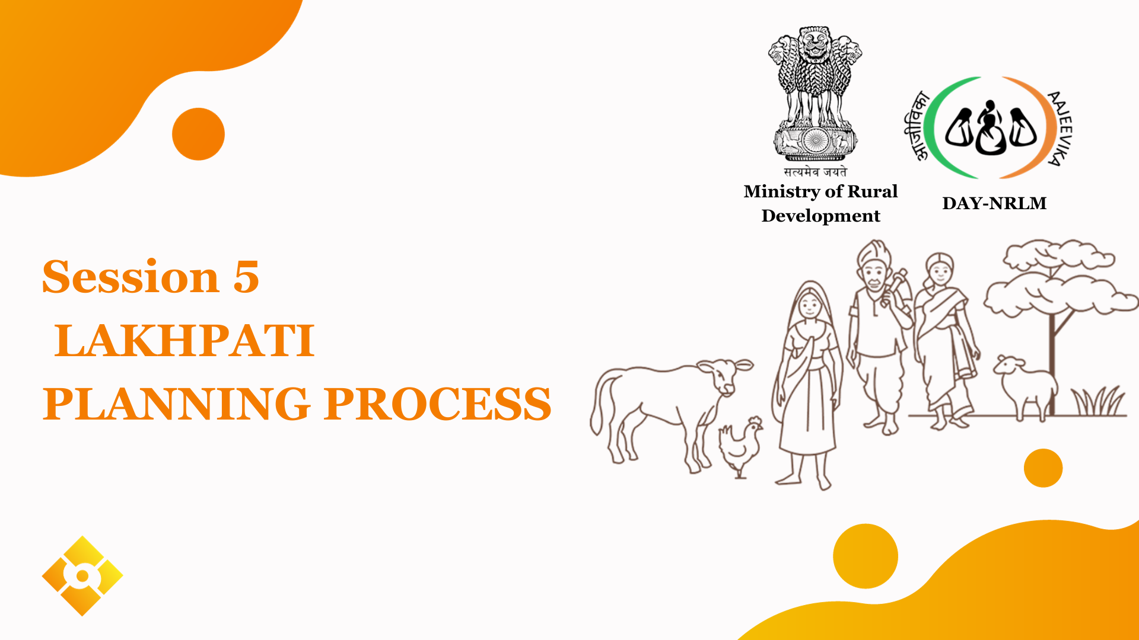
Notes:
This section will focus on understanding the concepts and elements of sustainable livelihoods.

Slide 2
Session Contents
Process for Lakhpati Livelihood Planning
Steps for Livelihood Planning with Lakhpati Didis
Points of Reference for Lakhpati-CRP during Plan Preparation
Overview of Components in the Lakhpati Planning Format
Group Exercise

Slide 3
Process for Lakhpati Livelihood Planning
Orientation of CLF, VO on Lakhpati Livelihood and their Role
CRP training by Master trainer
SHG members orientation by Lakhpati CRP
Identified Lakhpati Didi’s Livelihood Profile and Plan preparation using identified tools (digitization support by e-CRP)supported by the experts in the concerning field of activity
Consolidation of Plans - SHG, VO and CLF wise
Analysis of Plans by VO/CLF supported by block SRLM team
Facilitation for funding and resource support
Planning process
Planning tool
Components of template
Questions

Slide 4
Steps for Livelihood Planning with Lakhpati Didis by CRP
Orientation/Trg of identified SHG members - by CRP at VO meeting
The date and time for preparing Livelihood Plans of Lakhpati Didis- decided during this orientation meeting
The CRP interact with Lakhpati Didis for preparing the Livelihood Plans using the planning tool
Sections in the LH Planning template:
Profile Section
Livelihood activity(ies) identification
Support required for identified Livelihood Activities
Planning process
Planning tool
Components of template
Questions

Slide 5
Points of Reference for CRP During Plan Preparation
The Lakhpati Didi must discuss and decide the livelihood activity/ activities in consultation with her family
The existing assets, skills and resources available with the Lakhpati Didi HH must be discussed for each identified activity
The economics (cost - benefit) of each identified activity must be understood by the Didi
CRP must discuss the associated risks (Production risk, market risk, etc) with the SHG HH before finalising the activity
The resources / support required for the identified activities from outside must be identified by Lakhpati Didi and noted by the CRP in the tool
Training materials and Reference Documents must be readily available with the CRP during Plan Preparation.
Planning process
Planning tool
Components of template
Questions

Slide 6
Overview of Components in the Planning Tool
Section-1: Member profile
Section-2: Livelihood activity and Estimated income
Section-3: Support requirement for Livelihood Activities
The purpose of data collection
capture calculate current household income
Support household in developing livelihoods plan for next year after making them aware about various livelihood options available (taking into account their current assets skills and access to market/finance
Support HH members in identifying support required to take up future livelihood and thus enhancing their annual income
Planning process
Planning tool
Components of template
Questions

Slide 7
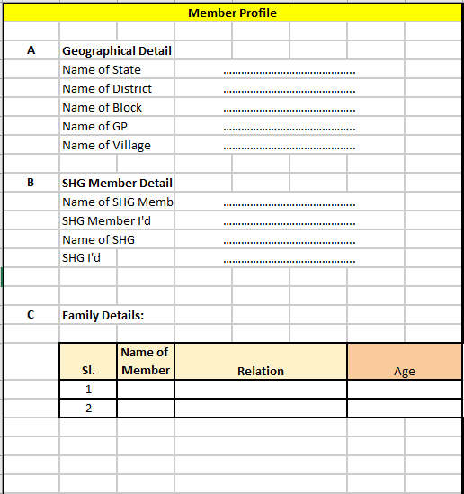
Section-1: Member Profile
Location Of SHG
Family Member details:
Loan for Lh by HH
Membership of Business organisation
Point of caution:
Double counting of HHs members to be avoided.
https://docs.google.com/spreadsheets/d/12sytH15UkZni43aQvD3J5waHubAG1w-4/edit?usp=sharing&ouid=107469613829008637202&rtpof=true&sd=true
Planning process
Planning tool
Components of template
Questions

Slide 8
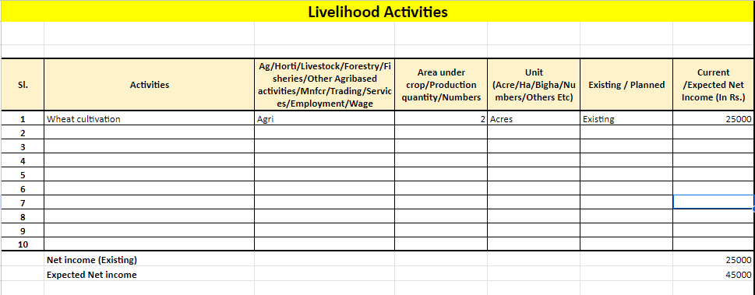
Section-2: Livelihood Activities and estimated net income
Name of the Activities
Group of livelihood under which activity falls
Unit to be defined as area under cultivation /number of livestock/area under aquaculture OR
Quantity produced in Kgs etc
Status of Activity: Existing/New
Expected income.
Conclusion: After filling the data, one can see the income from existing and newly planned activity.
Planning process
Planning tool
Components of template
Questions

Slide 9
Section 2 : How to fill the Column B
Components of Agriculture
Crop cultivation: Growing different crops like wheat, paddy, ragi etc.
Horticulture: growing flowers,fruits and vegetables
Livestock: Domesticated animals raised in agricultural base to produce diversified products like meat,egg,milk,etc
Forestry: Products obtained from forest for consumption like honey
Fisheries and aqua farming: cultivation of aquatic organisms such as fish,shellfish and plants
Other agri based activities: Tea,coffee, arecanut, spices,cashewnut, cocoa,etc.
Components of non farm sector
Manufacturing units: Making flour of crops like wheat, rice etc, agarbatti , making agarbatti from purchase of raw material,
Trading: Selling of bought products to the customers without processing, running a kirana shop
Services: Provides intangible goods banking, education, medical , value addition in production of goods

Slide 10
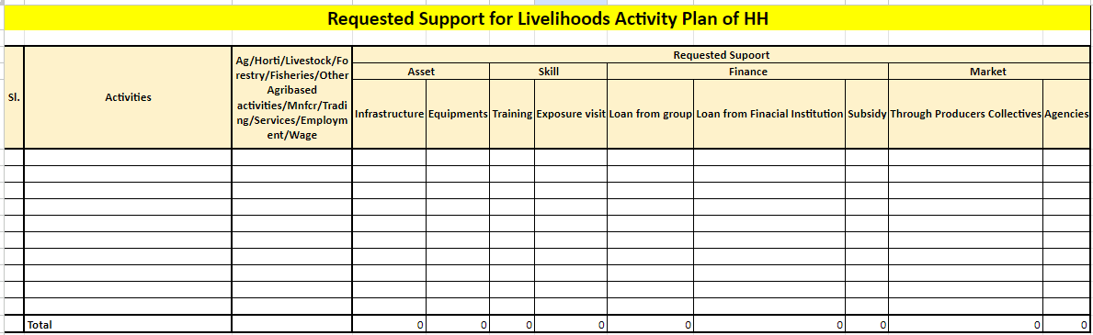
Section-3: Support requirement
Assets- Equipment, Infrastructure
Skills- Need for training and Exposure
Access to Finance- CIF/ Bank Linkage
Access to Market- PG/PE/FPO/ Other Market Players
Planning process
Planning tool
Components of template
Questions

Slide 11
Group Exercise
Create a Livelihood Plan for the Lakhpati Didis in the LH Planning Format
TASK 1:
Current activity: Wheat cultivation in 1 Acre of land and working as wage labourer
Future plan:
Farming –
Activity: Cereals - Maize in 1 Acre
Support Required: Equipment - Thresher
Other Farm Based -
Activity: Other Farm Based - Honey
Support Required: Equipment - Honey Extractor
TASK 2
Current activity: Paddy in one acre
Poultry birds- 5 desi
Desi Cow: 2
Future plan:
Farming –
Activity: Paddy in 1 Acre and vegetables in 1 acre for 3 months
Support Required: Input - Organic Manure and market for vegetable
Animal Husbandry –
Activity: Poultry with 10 kadaknath birds
Support Required: Training for poultry Infrastructure - Chick Guard
Cattle: 2 desi and two crossbred cows
Support Required: Training on managing cross bred cattle, subsidy
ME / Non Farm -
Activity: Pickle Making
Support Required: Subsidy
TASK 3
Current activity: Maize in 1.5 acre
Poultry: 5 Desi birds
Future plan:
Farming –
Activity: Maize in 1.5 Acre, veg- for 5 months in 1.5 acre
Support Required: Marketing Support
Animal Husbandry –
Activity: Poultry Mother Unit with 500 Birds
Support Required: Training - Mother Unit Management Training , loan from
Non Farm –
Activity: Tailoring Unit
Support Required: Services - Mudra Loan

Slide 12
Questions??
Planning process
Planning tool
Components of template
Questions

Slide 13
Thank You

Slide 14
Components of livelihood plan template-3
Non farm activity -1
Your solution
how will you fulfill this need (define your product)
what value are you adding
3. Market Analysis
What industry are you competing
Customer Segment – needs of each set of customers
Product for each segment
Size
trends
Introduction:
Basic background
Business products/services
Owner’s background
Opportunity
What is the need / pain – how strong is the pain
who has it (define your customer)
why will they pay for it?
Planning process
Planning tool
Components of template
Questions

Slide 15
Components of livelihood template-2
Non farm activity -current/future plan-2
4. Competitor analysis
Who are the current competitors
What resources do they control, what are their strengths and weaknesses
How will they respond to us & How can we respond to their response
5. Financial
Source of funds
Fixed and working capital
6. Marketing plan
Price
Quality
Products
Promotion
7. Operations
production, distribution, sales & marketing
Govt regulations
Relation with different stakeholders
8. Risks
What can go wrong?
Alternate plan?
Planning process
Planning tool
Components of template
Questions

